Slide 1
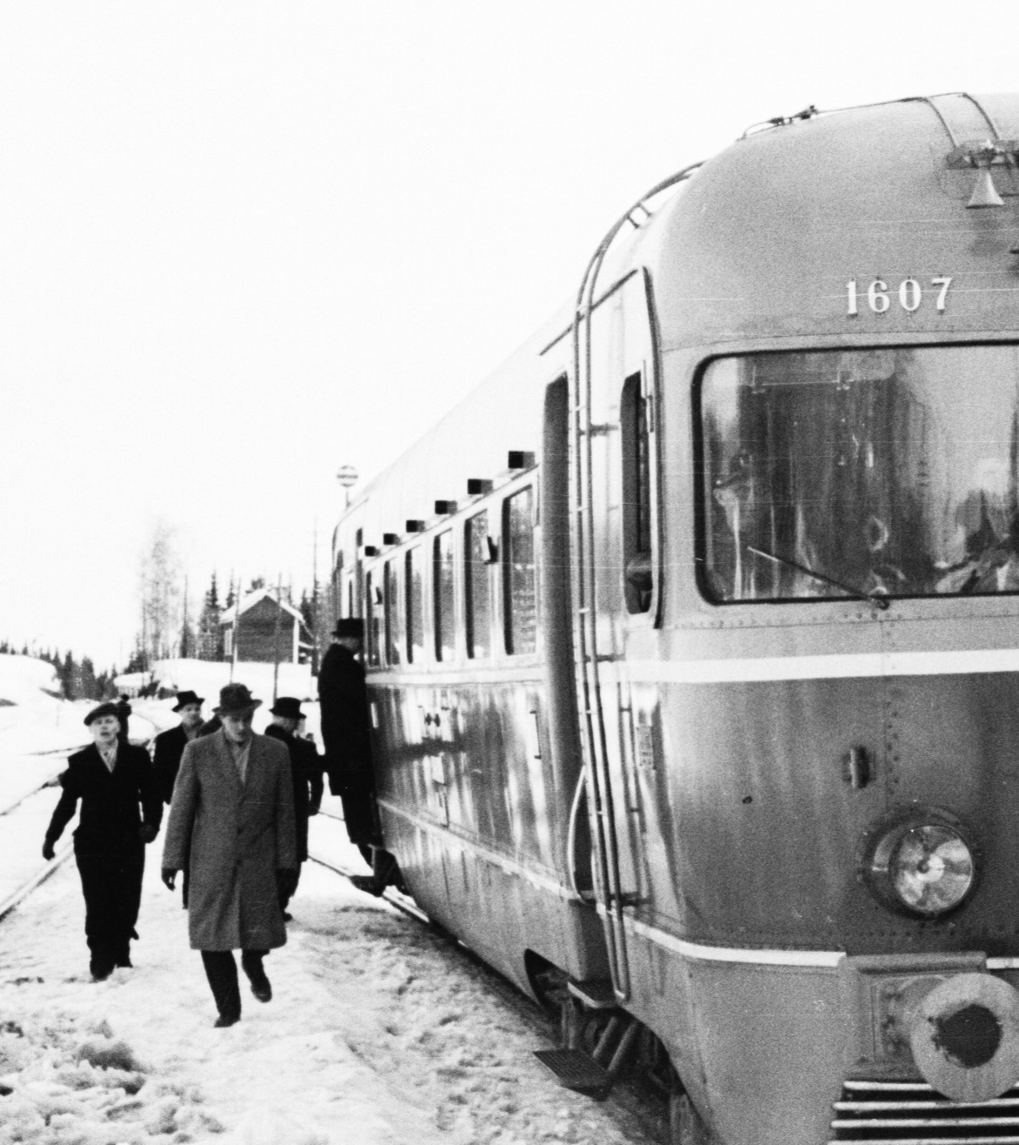
Predicting Weather Inflicted Train Delays
Finnish Meteorological Institute
Roope Tervo
Laila Daniel
Photo by Kalevi Lehtonen 1955. Not published until Commons in 2014. https://fi.wikipedia.org/wiki/Tiedosto:Finnish_class_Dm4_locomotive_number_1607_in_the_year_1955.jpg

Slide 2
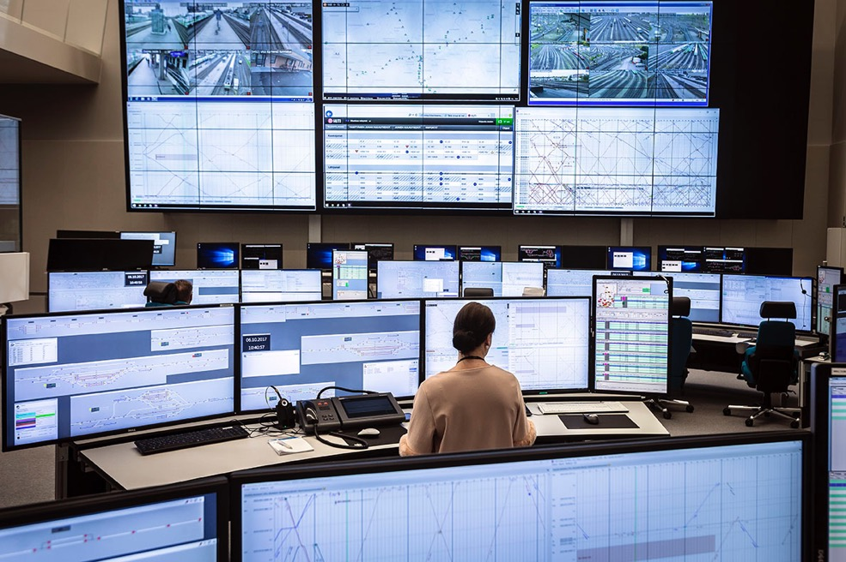
We aim to predict disruption of rail traffic caused by weather
Operation center can take several actions:
Reduce train shifts
Communicate
Project timeline: 01/2018-10/2018
Project partners: FMI, FTA, Trafi, VR
Area: Finland
Time range: 2 days ahead
Time step: 1 hour
Image: Solita Oy
Notes:
Message: motivation for the work is to be able to provide a tool for the rail traffic operation center
They can take actions: put more workforce on field, reduce train shifts
Communications is also important for pr
2

Slide 3
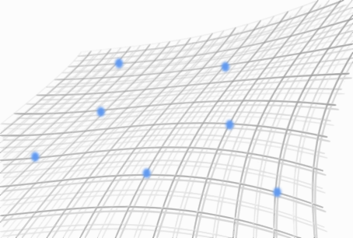
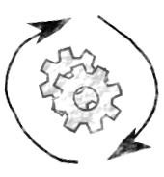
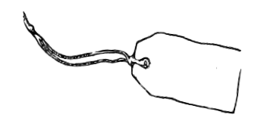
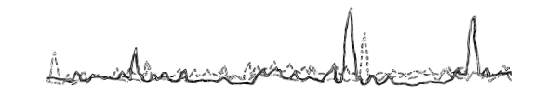
+
Label
data
Feature
data
Method
Results

Slide 4
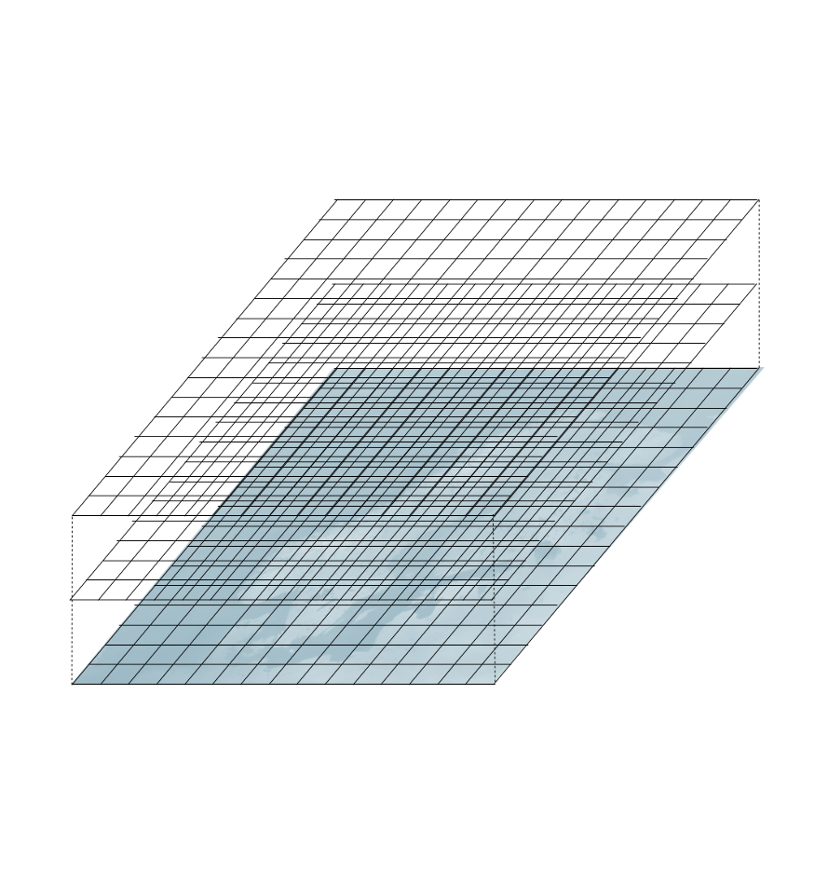
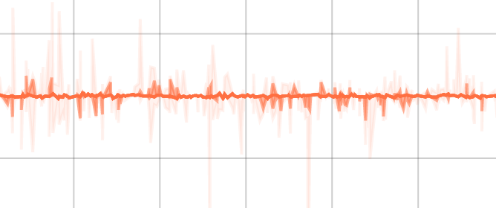
NWP
Method
Prediction

Slide 5
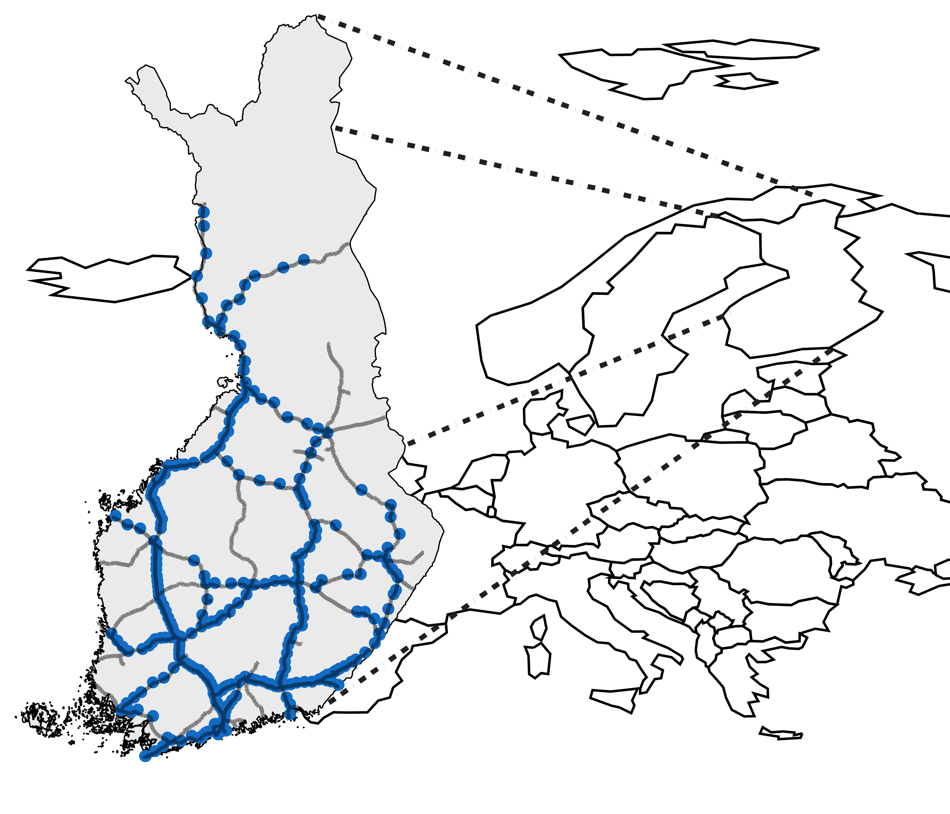
Data consist of train delays and corresponding weather observations
Delay between stations
Passenger trains
514 stations
Weather observations
19 parameters
Data from 2010 – 2018
30 M rows | 5.5 GB data
Data Liikennevirasto (CC4)
Notes:
Message: label data consists of trains delayed between stations
Length of history
Size of dataset
Passenger trains considered only
Other option as well
~10 trains per hour at busiest stations
Many stations host only few trains per day
Some stations contain only cargo traffic
Trains delayed at end station of the route
(minutes reported to every station to time stamp when train passed the stations
Four train types (intercity, commuter, cargo, other)
We consider only passenger trains
5

Slide 6
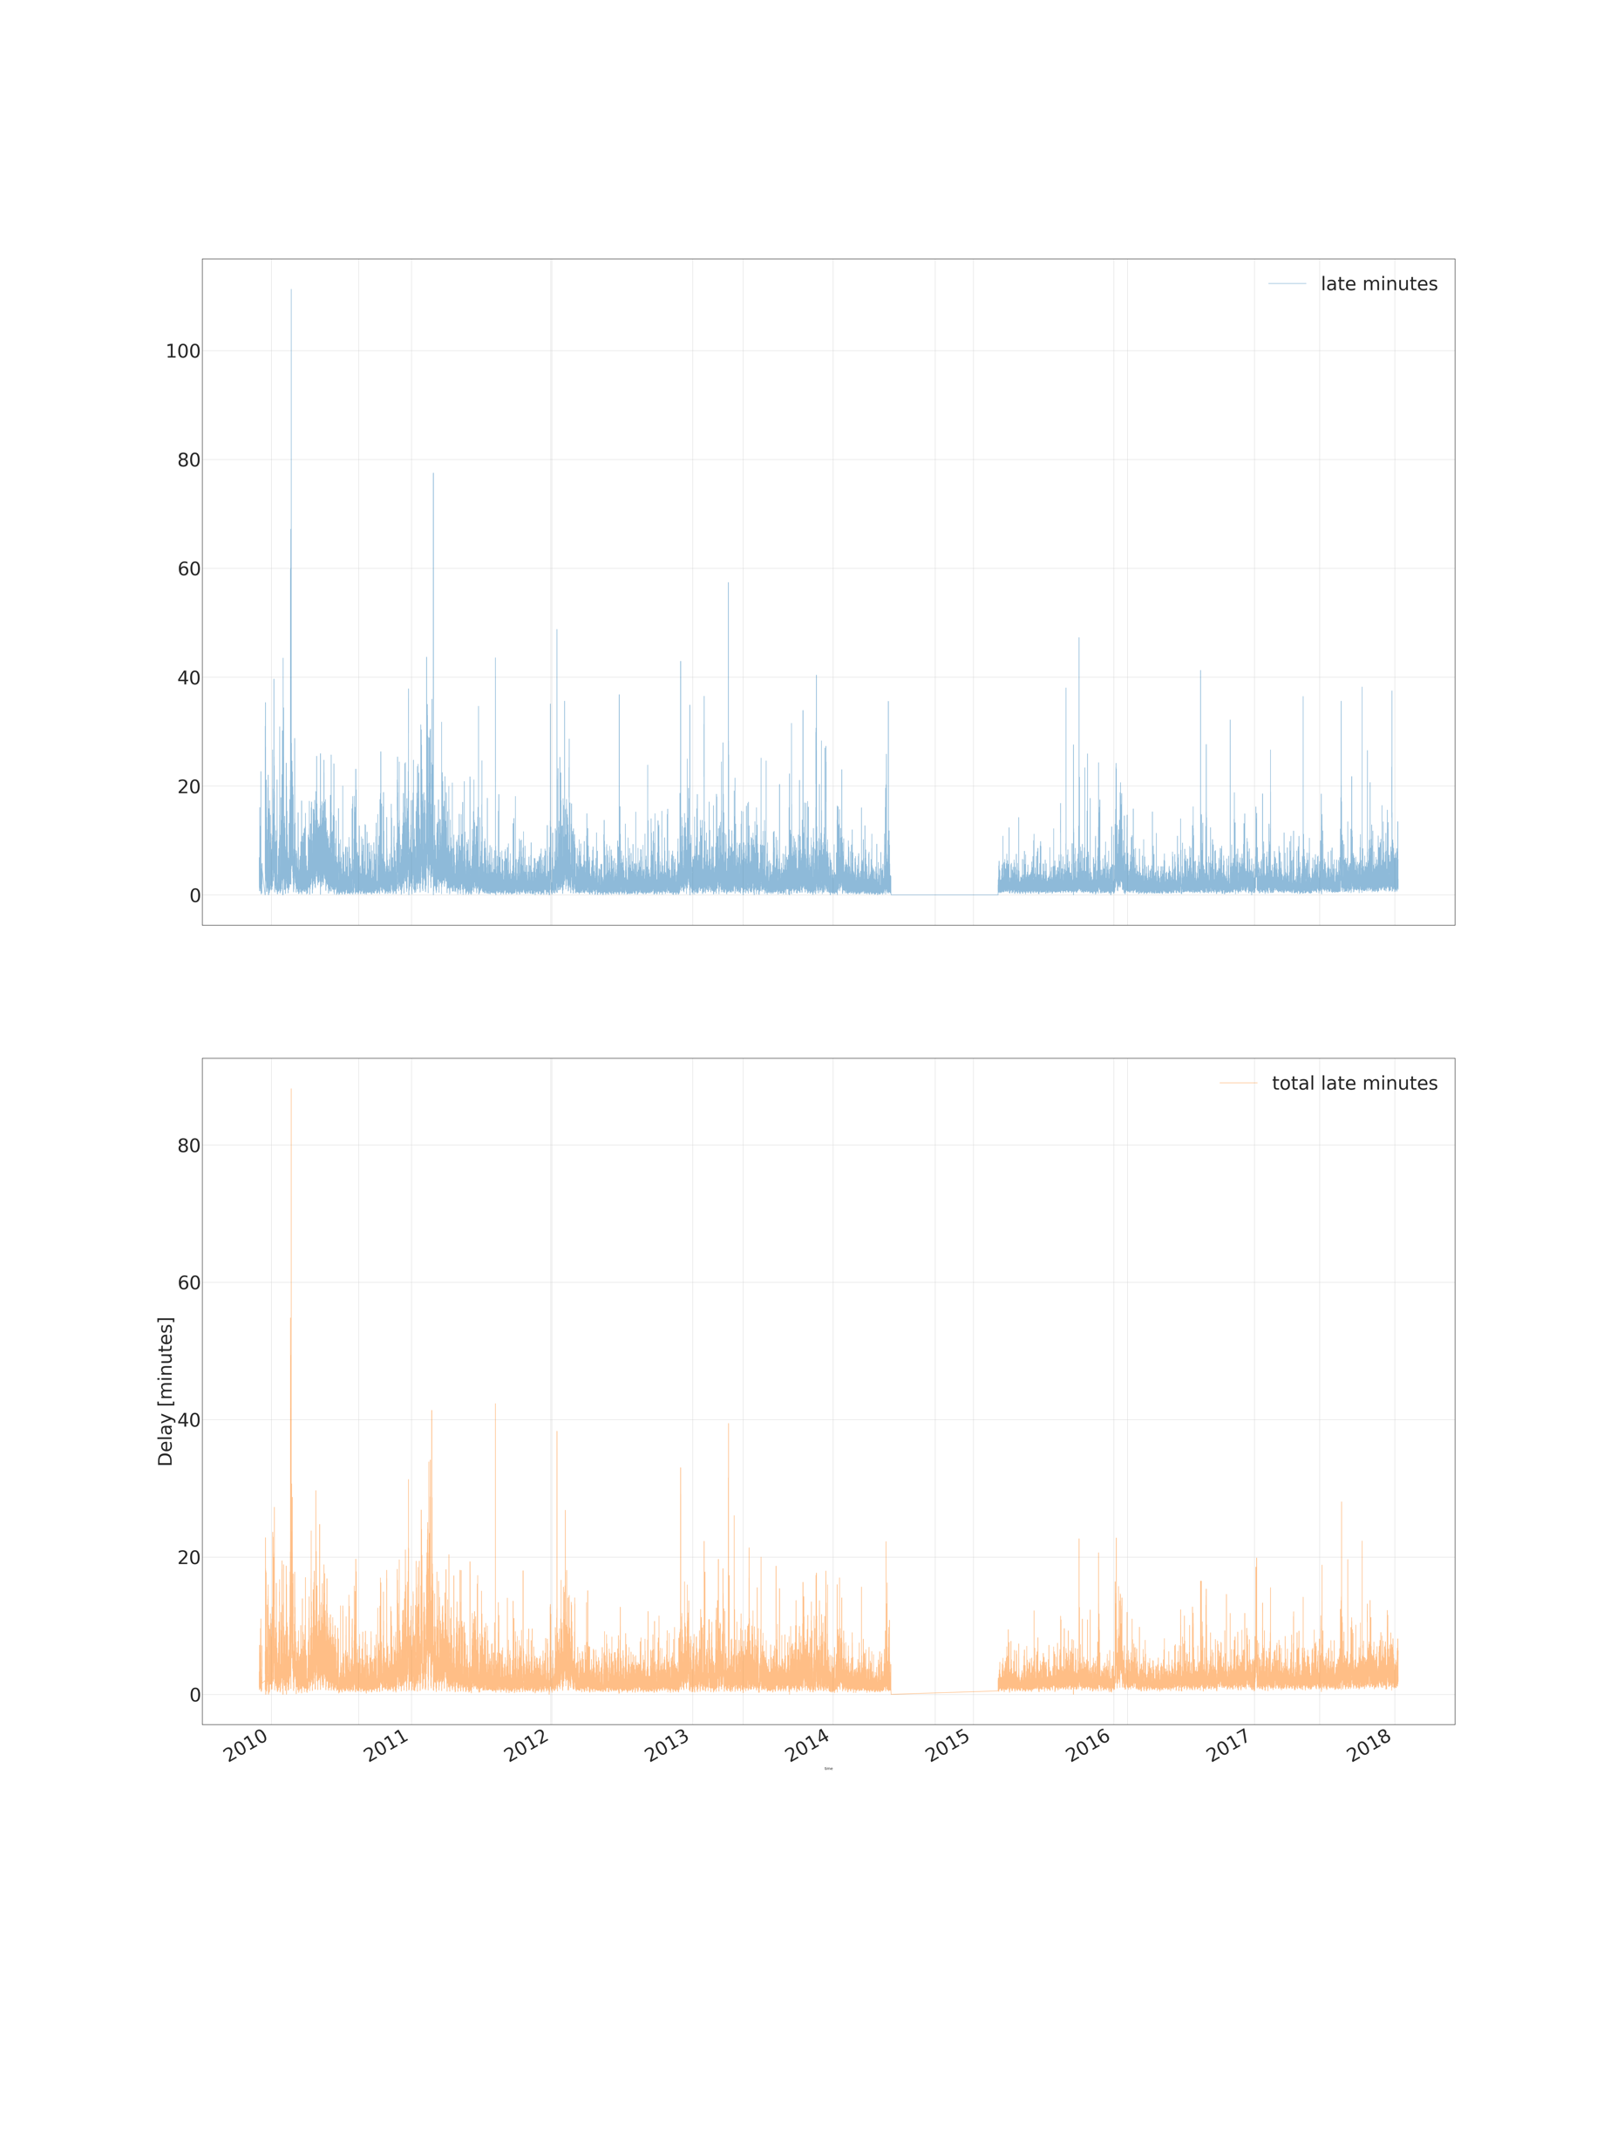
Most trains run in time
Mean delay over all stations
100
Minutes
50
0
2010
2014
2018
Notes:
Message: most of the time trains run in time but there are some very bad moments regularly

Slide 7
Most trains run in time
Mean delay over all stations
100
Minutes
50
0
2010
2014
2018
But severe delays happen quite regurarly every year
Notes:
Message: most of the time trains run in time but there are some very bad moments regularly

Slide 8
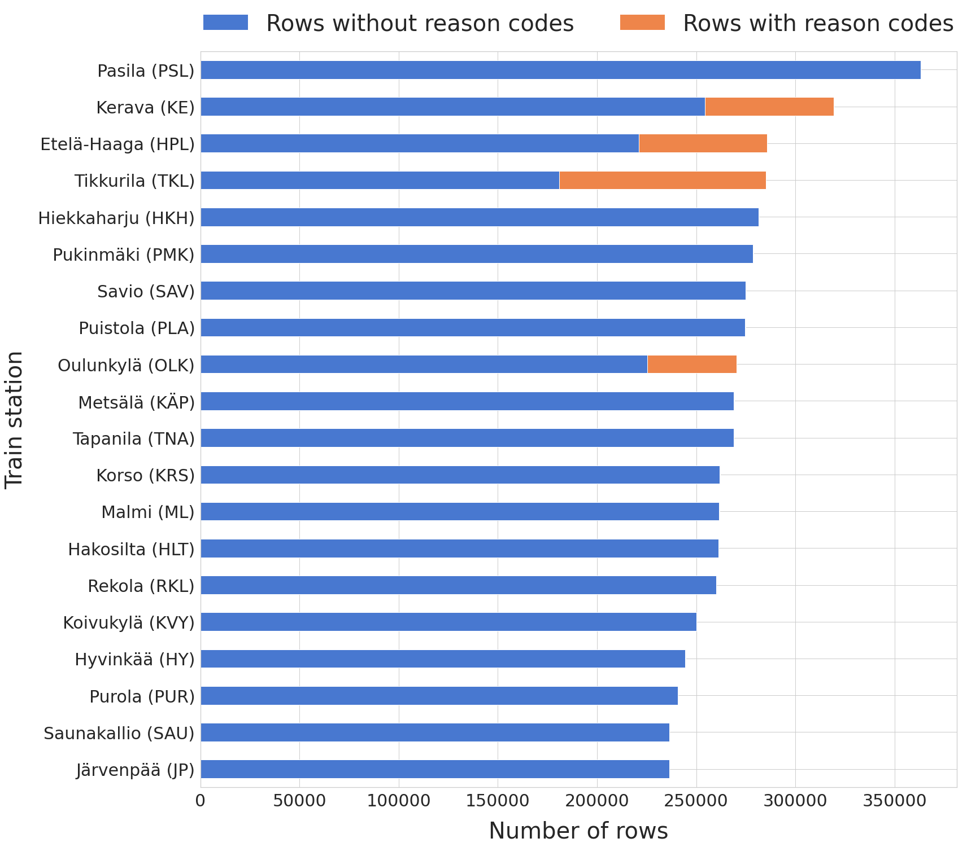
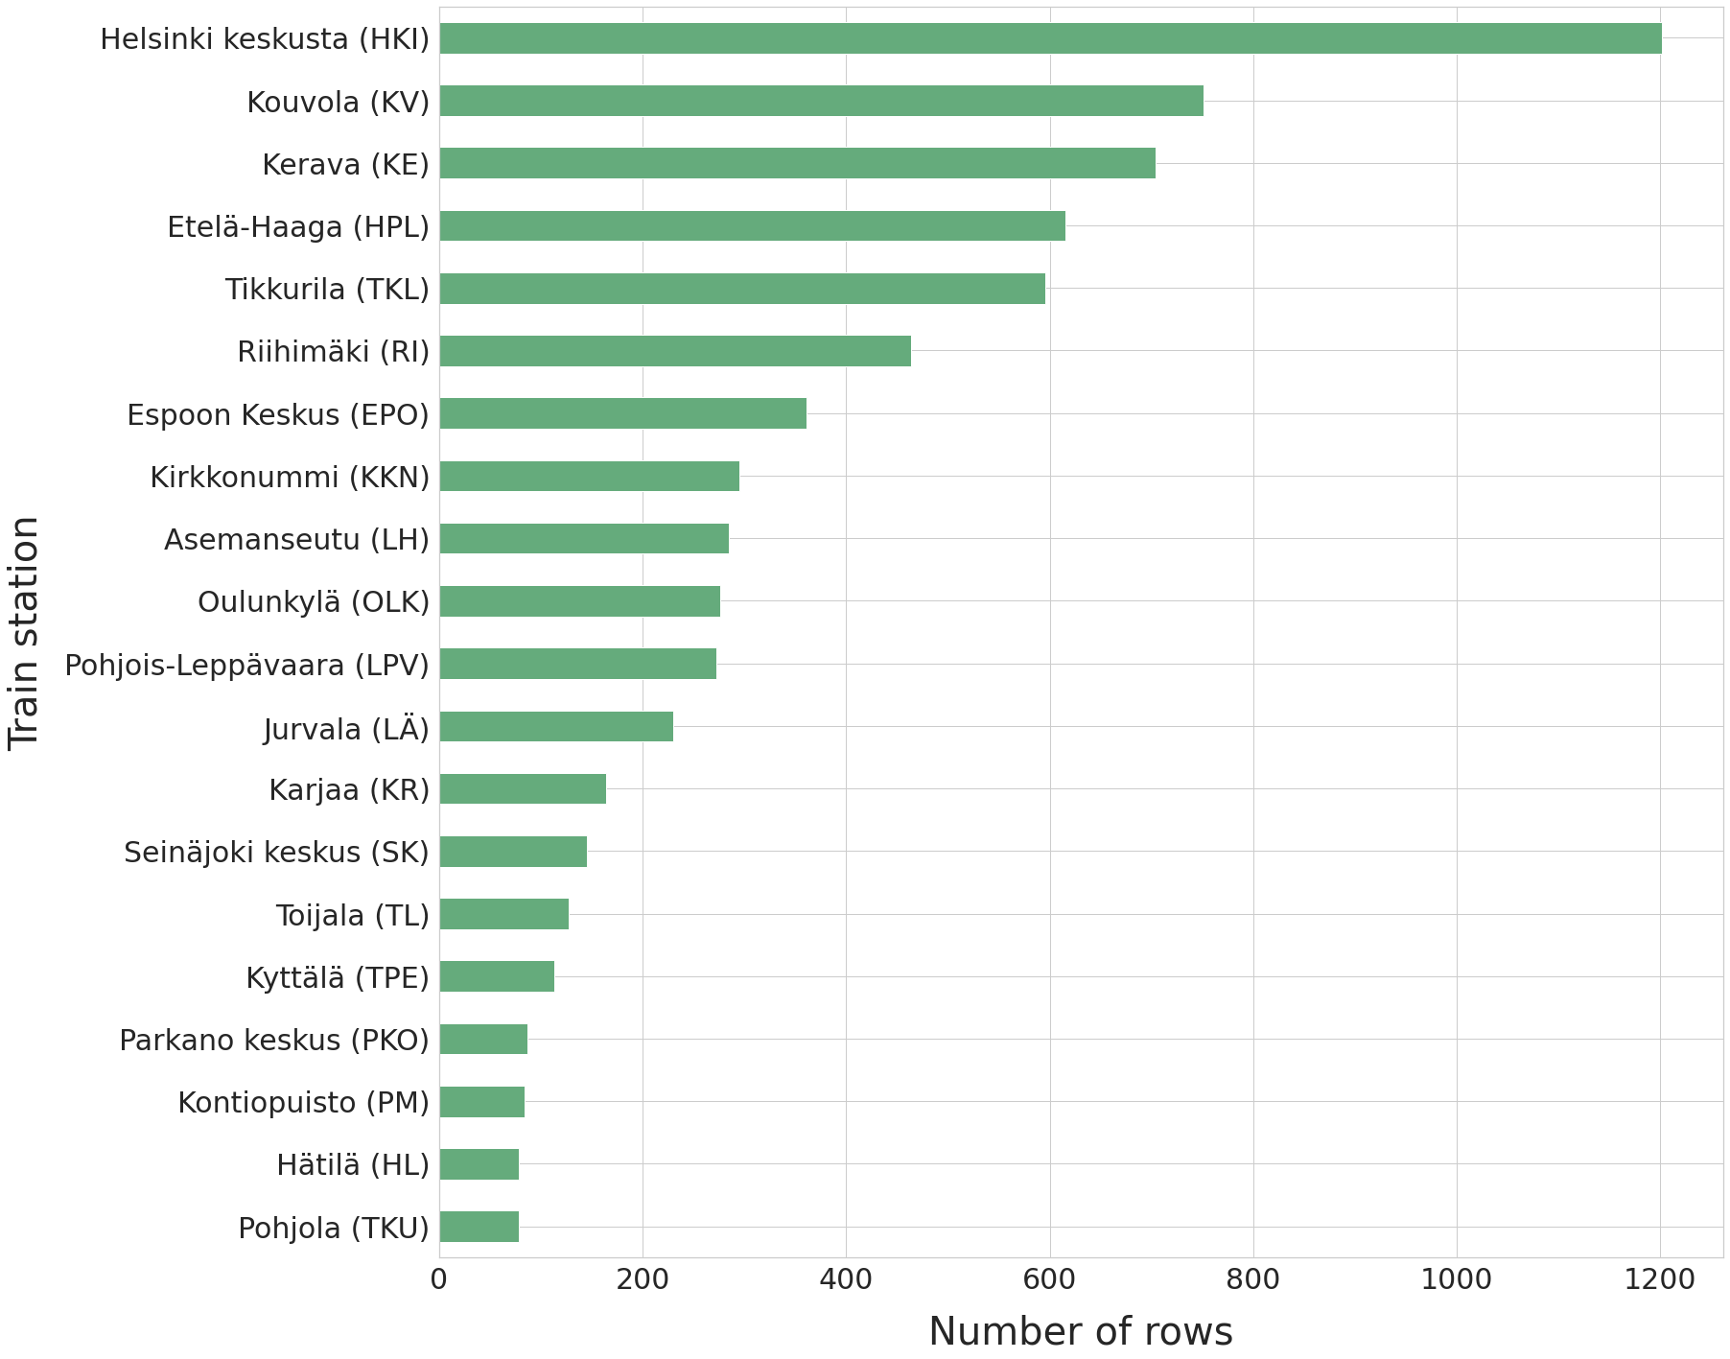
Most rows have no reason codes stored

Slide 9
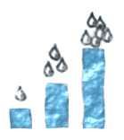
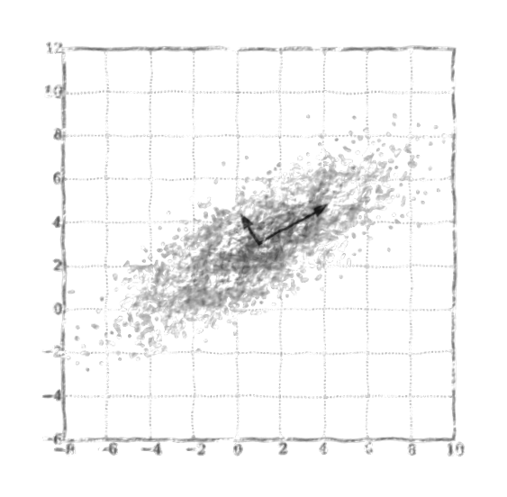
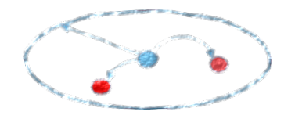
Various pre-processing methods used
Observations fetched with 100 km radius from train station using aggregation
Calculated 3h and 6h precipitation accumulation sums
Tried PCA, ICA and K-Means clustering
100km
Image: Roope Tervo 2018.
Original image: Nicoguaro. License: CC4-BY.
Notes:
Message: various pre-processing methods used for the features
Observations fetched with 100 km radius from train station using aggregation functions (min/max/mean/count) to minimize amount of missing values
Calculated 3h and 6h precipitation accumulation sums
Tried with and without imputation and normalisation
Tried also PCA, ICA and K-Means clustering
9

Slide 10


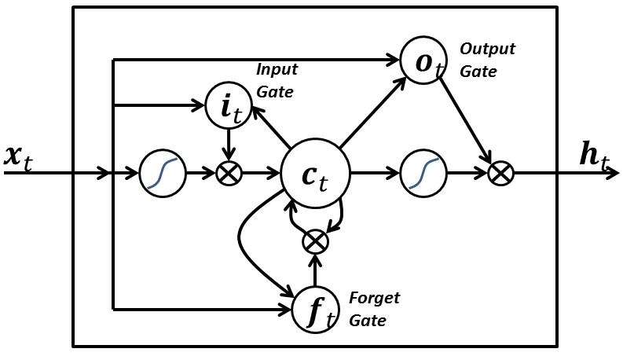
Three ML methods considered
LR
RFR
LSTM
Image: CC0
Image: Venkata Jagannath. License: CC4-BY
Image: BiObserver. License: CC4-BY
Random search used for finding optimal hyper parameters of LR and RFR
Notes:
Message: three separate ML methods considered
10

Slide 11
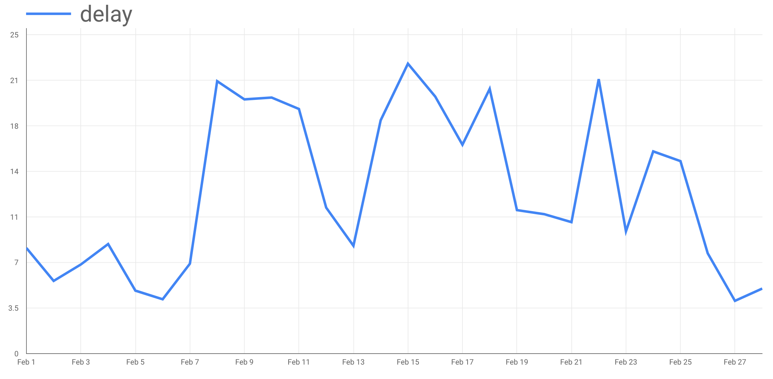
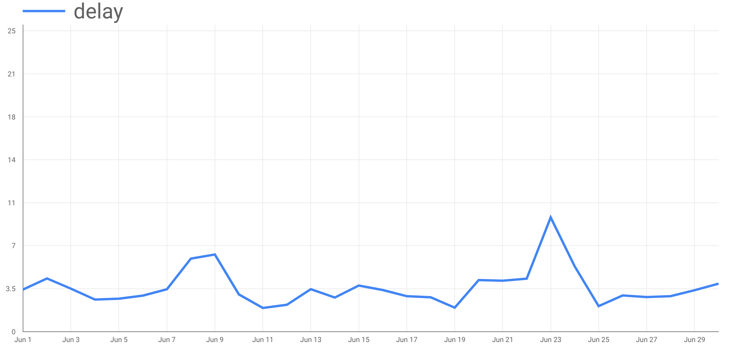
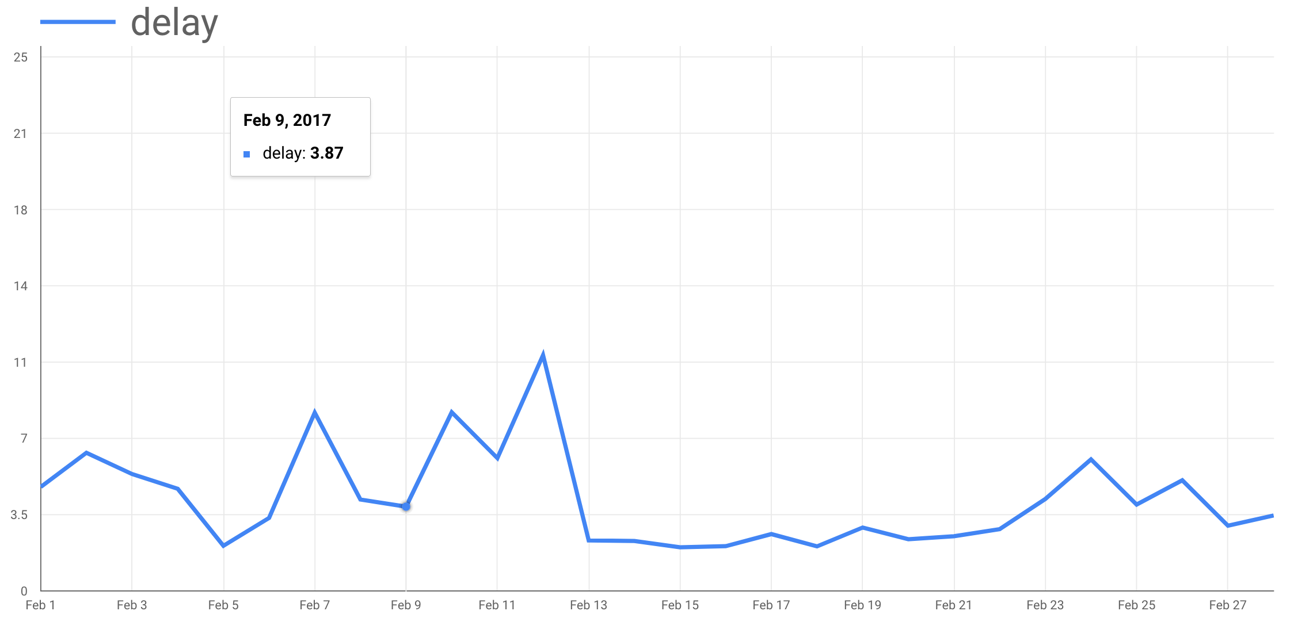
Three selected months picked out for testing performance
02/2011
06/2016
02/2017
Rest of the dataset splitted randomly to train and validation dataset with ratio 70/30 %
Notes:
Message 1: for features, we gather 19 weather parameters from nearest observation stations for every hour train has arrived to the station
Message 2: we use weather observation data for training but output of NWP for predicting delays

Slide 12
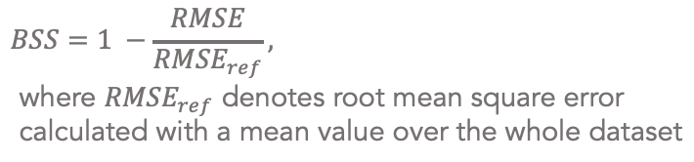
Results
LR
RMSE: 5.59
MAE: 3.11
BSS: 0.08
RFR
RMSE: 5.37
MAE: 3.21
BSS: 0.11
LSTM
RMSE: 4.35
MAE: 2.75
BSS: 0.01
Image: CC0
Image: Venkata Jagannath. License: CC4-BY
Image: BiObserver. License: CC4-BY
$$BSS=1 −\frac{RMSE}{{RMSE}_{ref}},$$
$$\text{where} {RMSE}_{ref} \text{denotes} \text{root} \text{mean} \text{square} \text{error} \text{calculated} \text{with} \text{a} \text{mean} \text{value} \text{over} \text{the} \text{whole} \text{dataset}$$
Notes:
Message: three separate ML methods considered
12

Slide 13
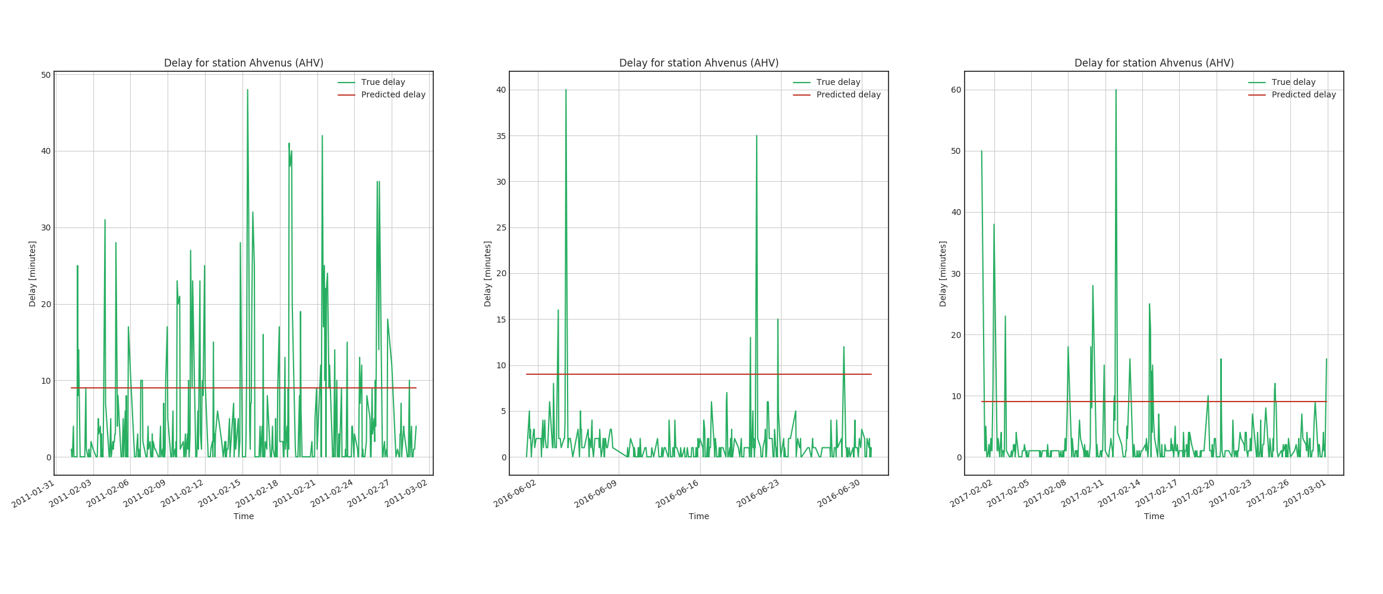
LSTM shows no real skill
Predicted delay
True delay
Predicted vs. true delay, case Ahvenus
50
25
Delay (minutes)
0
Time 02/2011
Time 06/2016
Time 02/2017
Notes:
Message: LSTM gave good results in term of RMSE but shows no real skill

Slide 14
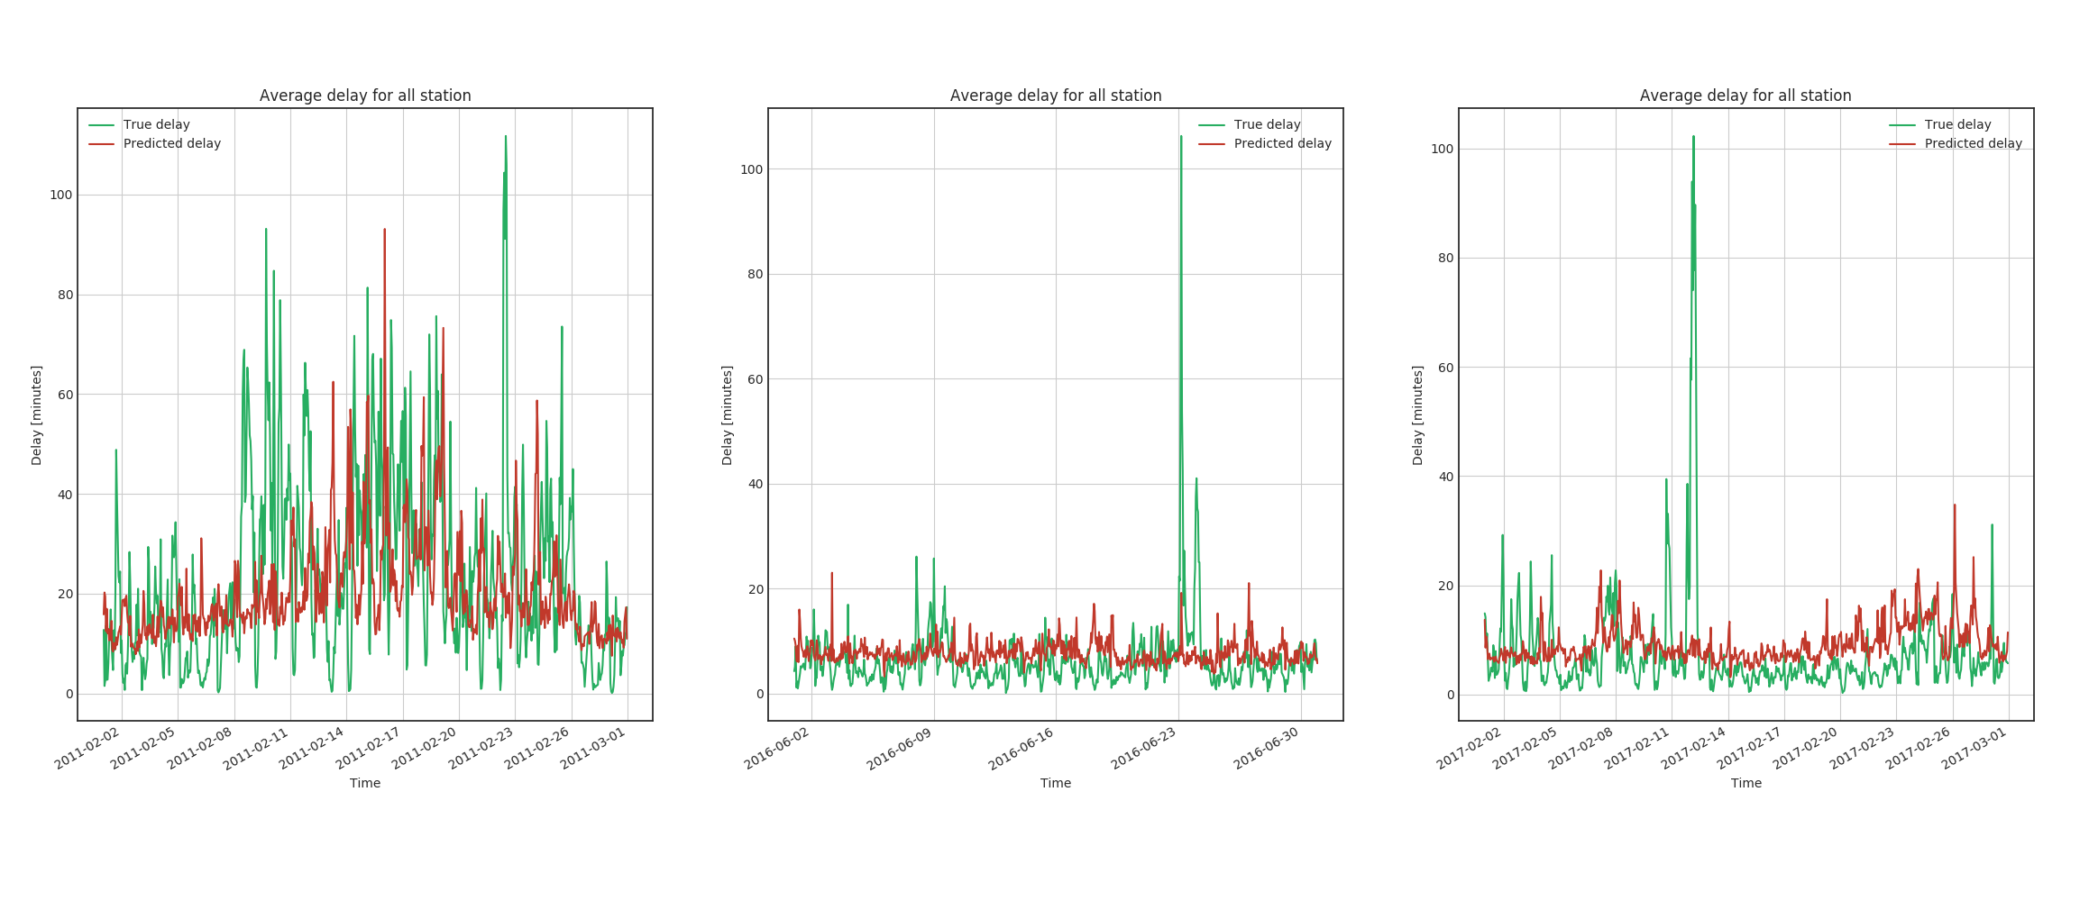
RFR works relatively well
Predicted delay
True delay
Predicted vs. true delay, average over all stations
100
Delay (minutes)
50
0
Time
02/2011
Time
06/2016
Time
02/2017
Notes:
Message: best RFR prediction followed actual observations relatively well
14

Slide 15
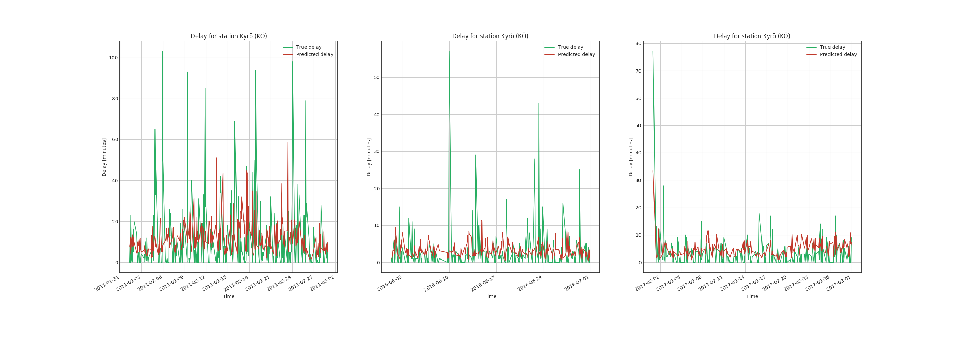
RFR works well for most individual stations
Predicted vs. true delay, case Kyrö
s
100
Delay (minutes)
50
0
Time 02/2011
Time 06/2016
Time 02/2017
Notes:
Message: for most single stations, RFR works quite well

Slide 16
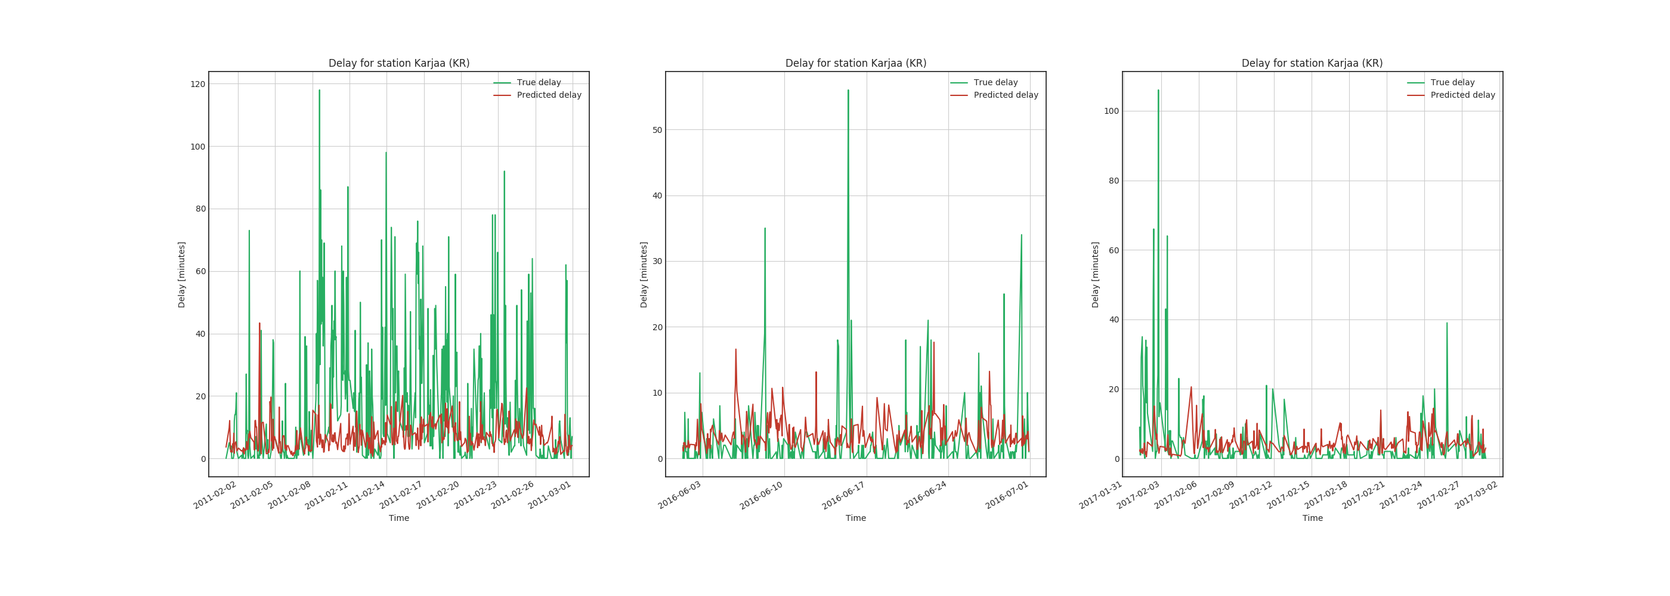
RFR don’t work for all cases
Predicted delay
True delay
Predicted vs. true delay, case Karjaa
s
100
Delay (minutes)
50
0
Time 02/2011
Time 06/2016
Time 02/2017
Notes:
Message: for most single stations, RFR works quite well

Slide 17
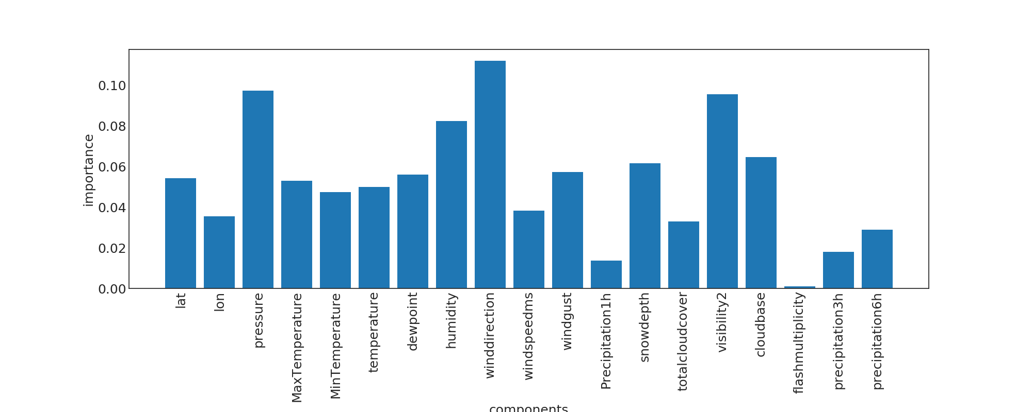
Wind direction, pressure and visibility are the most important features
Notes:
Message: based on RFR, two out of 19 features provided no value
6h precipitation sum
Lightning density
humidity

Slide 18
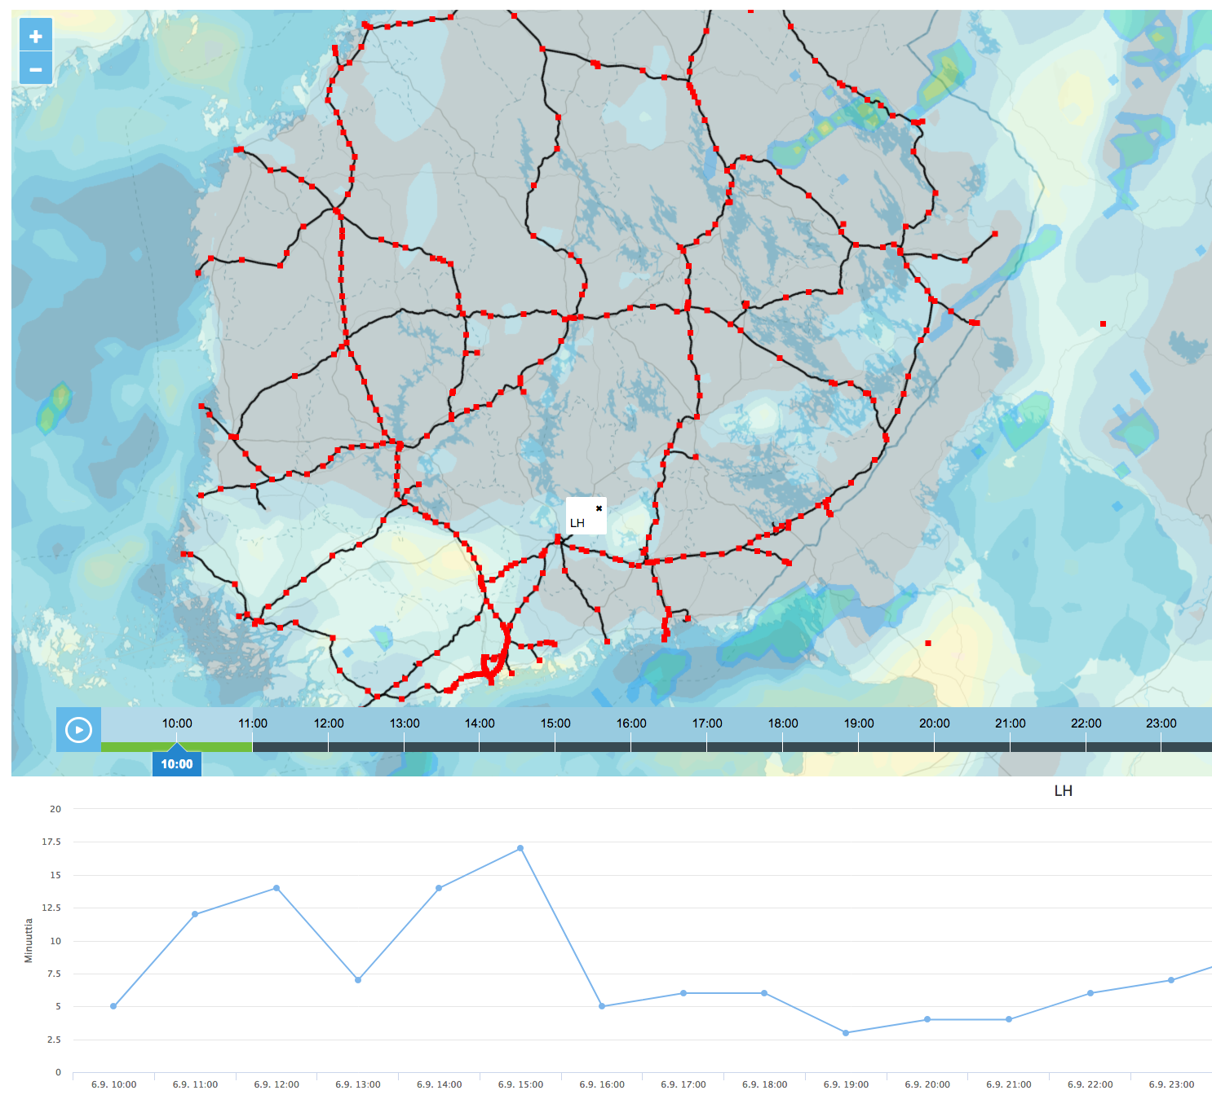
Predictions are delivered to end users via web interface
Notes:
Message: end predictions are delivered to end users via web interface

Slide 19
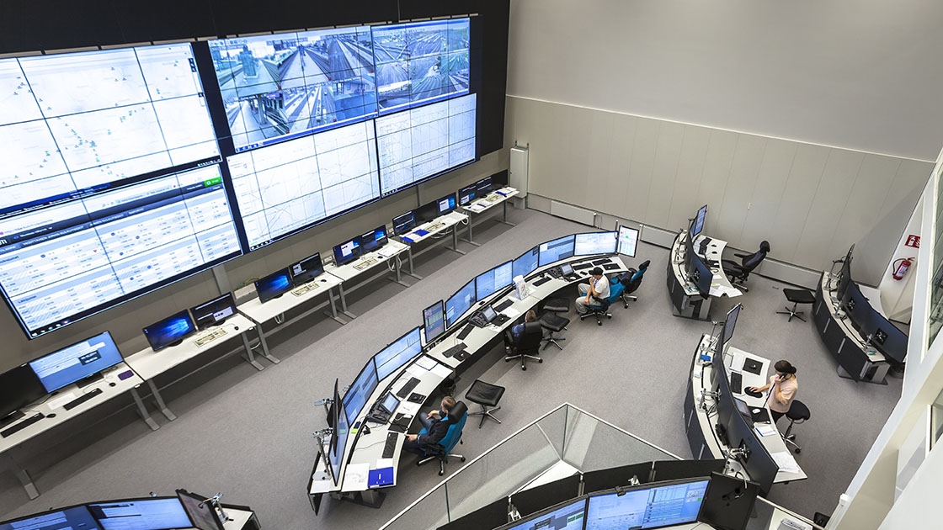
Train delays can be predicted based on weather conditions
RFR gives the best average prediction
…although its performance is not steady
Image: Solita Oy
Notes:
19

Slide 20
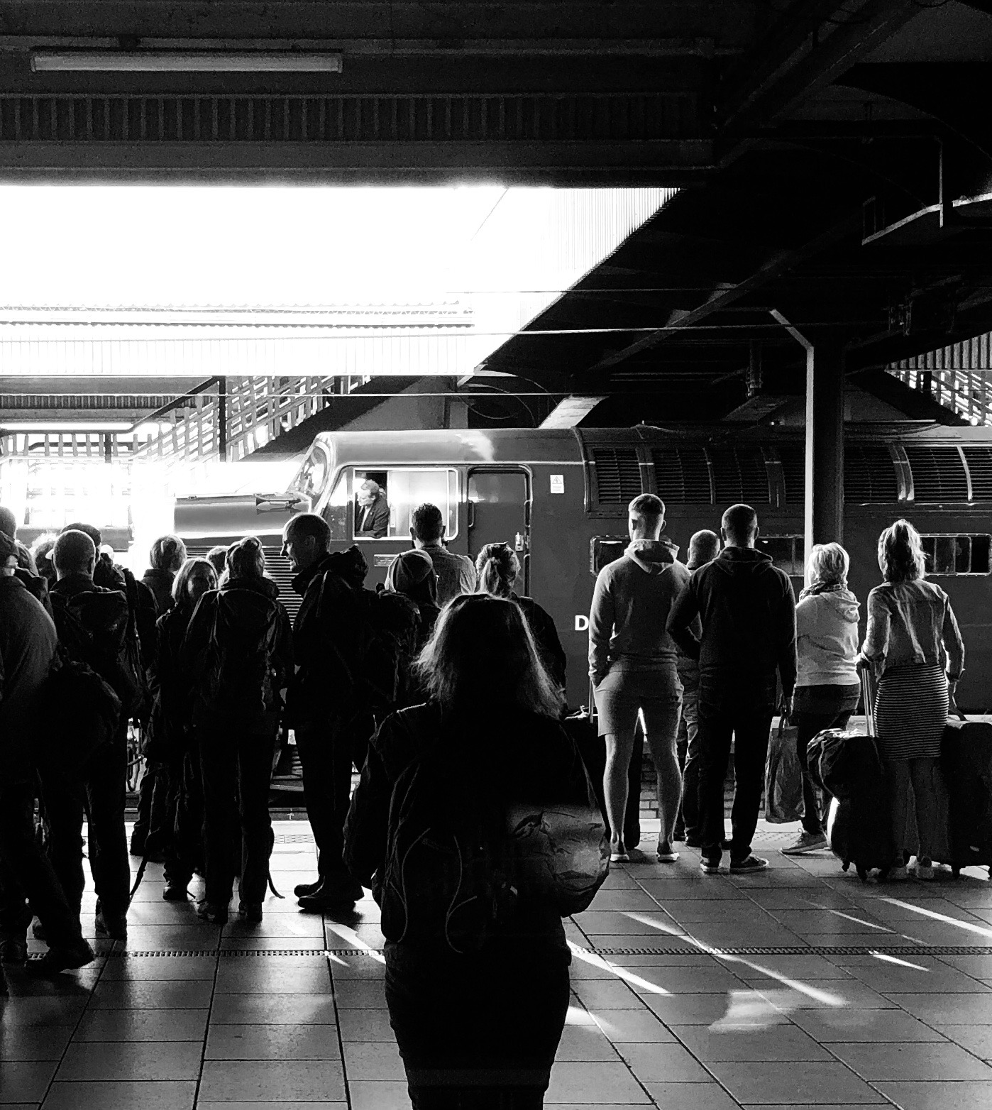
Questions
roope.tervo@fmi.fi
CC0. Image by: Simon Jowett

